Slide 1
eMart
The Online Marketplace
Group Project – CO226
Group 03
E/18/028 – Ariyawansha P. H. J. U.
E/18/173 – Kasthuripitiya K. A. I. M.
E/18/285 – Ranasinghe S. M. T. S. C.

Slide 2
Content
Description
Users and their requirement
Conceptual model
Logic model

Slide 3
Description
eMart is an online marketplace
This Provides services and supplies
It saves customers’ time and money
Keeps users’ data safe and tracks all the information of products
Easy to update, delete and add records
Make employees’ jobs easy
Manage payment details of customers and employees
Notes:
eMart to reach customers who want to purchase their products and services
All the services and supplies
Objectives of database

Slide 4
Users and their Requirements
Customer
Should register on the system
Can surf on the eMart
Experience all the services
Choose suitable payment options
Employee
Should register on the service
Provide services
Can identify employers’ requirements
Can get real-time payments
Administrator
Not ordinary users
Authority to add or remove users and items
Permission to update the prices
Manage details of customers and employees
Manage details of services and products
Notes:
Administrator are not users but owners of the system and they can

Slide 5
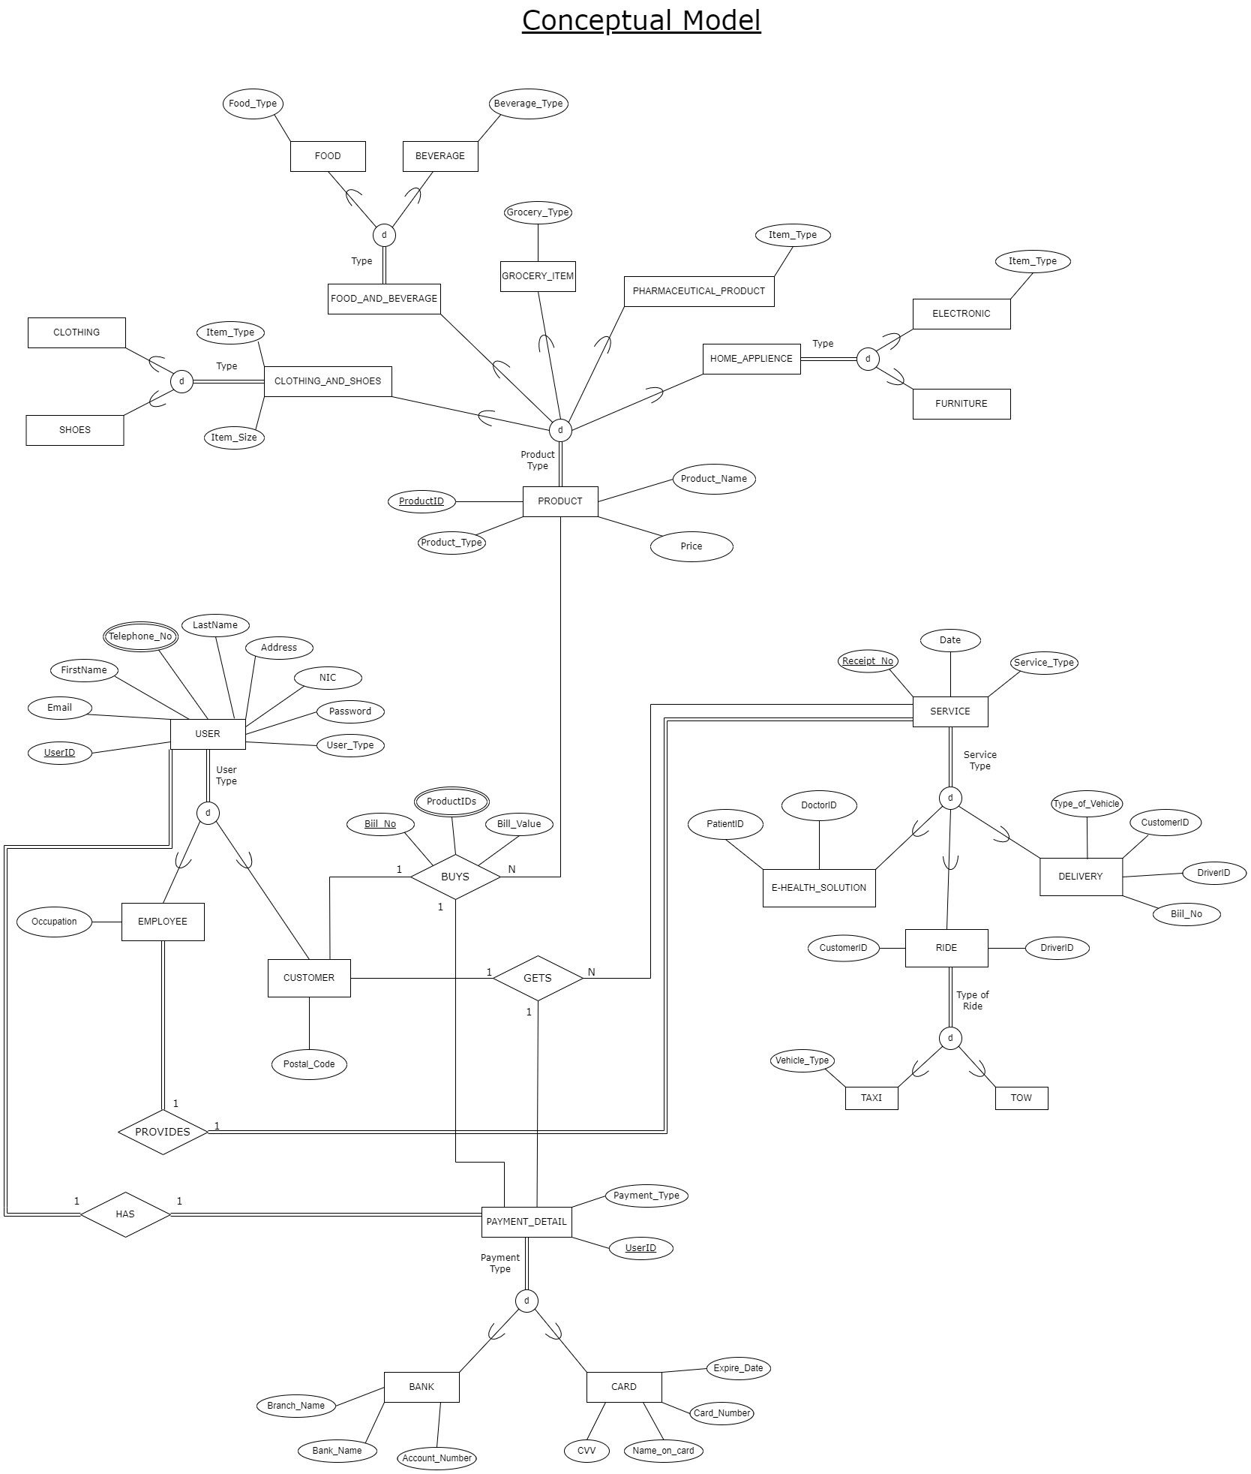
Conceptual Model

Slide 6
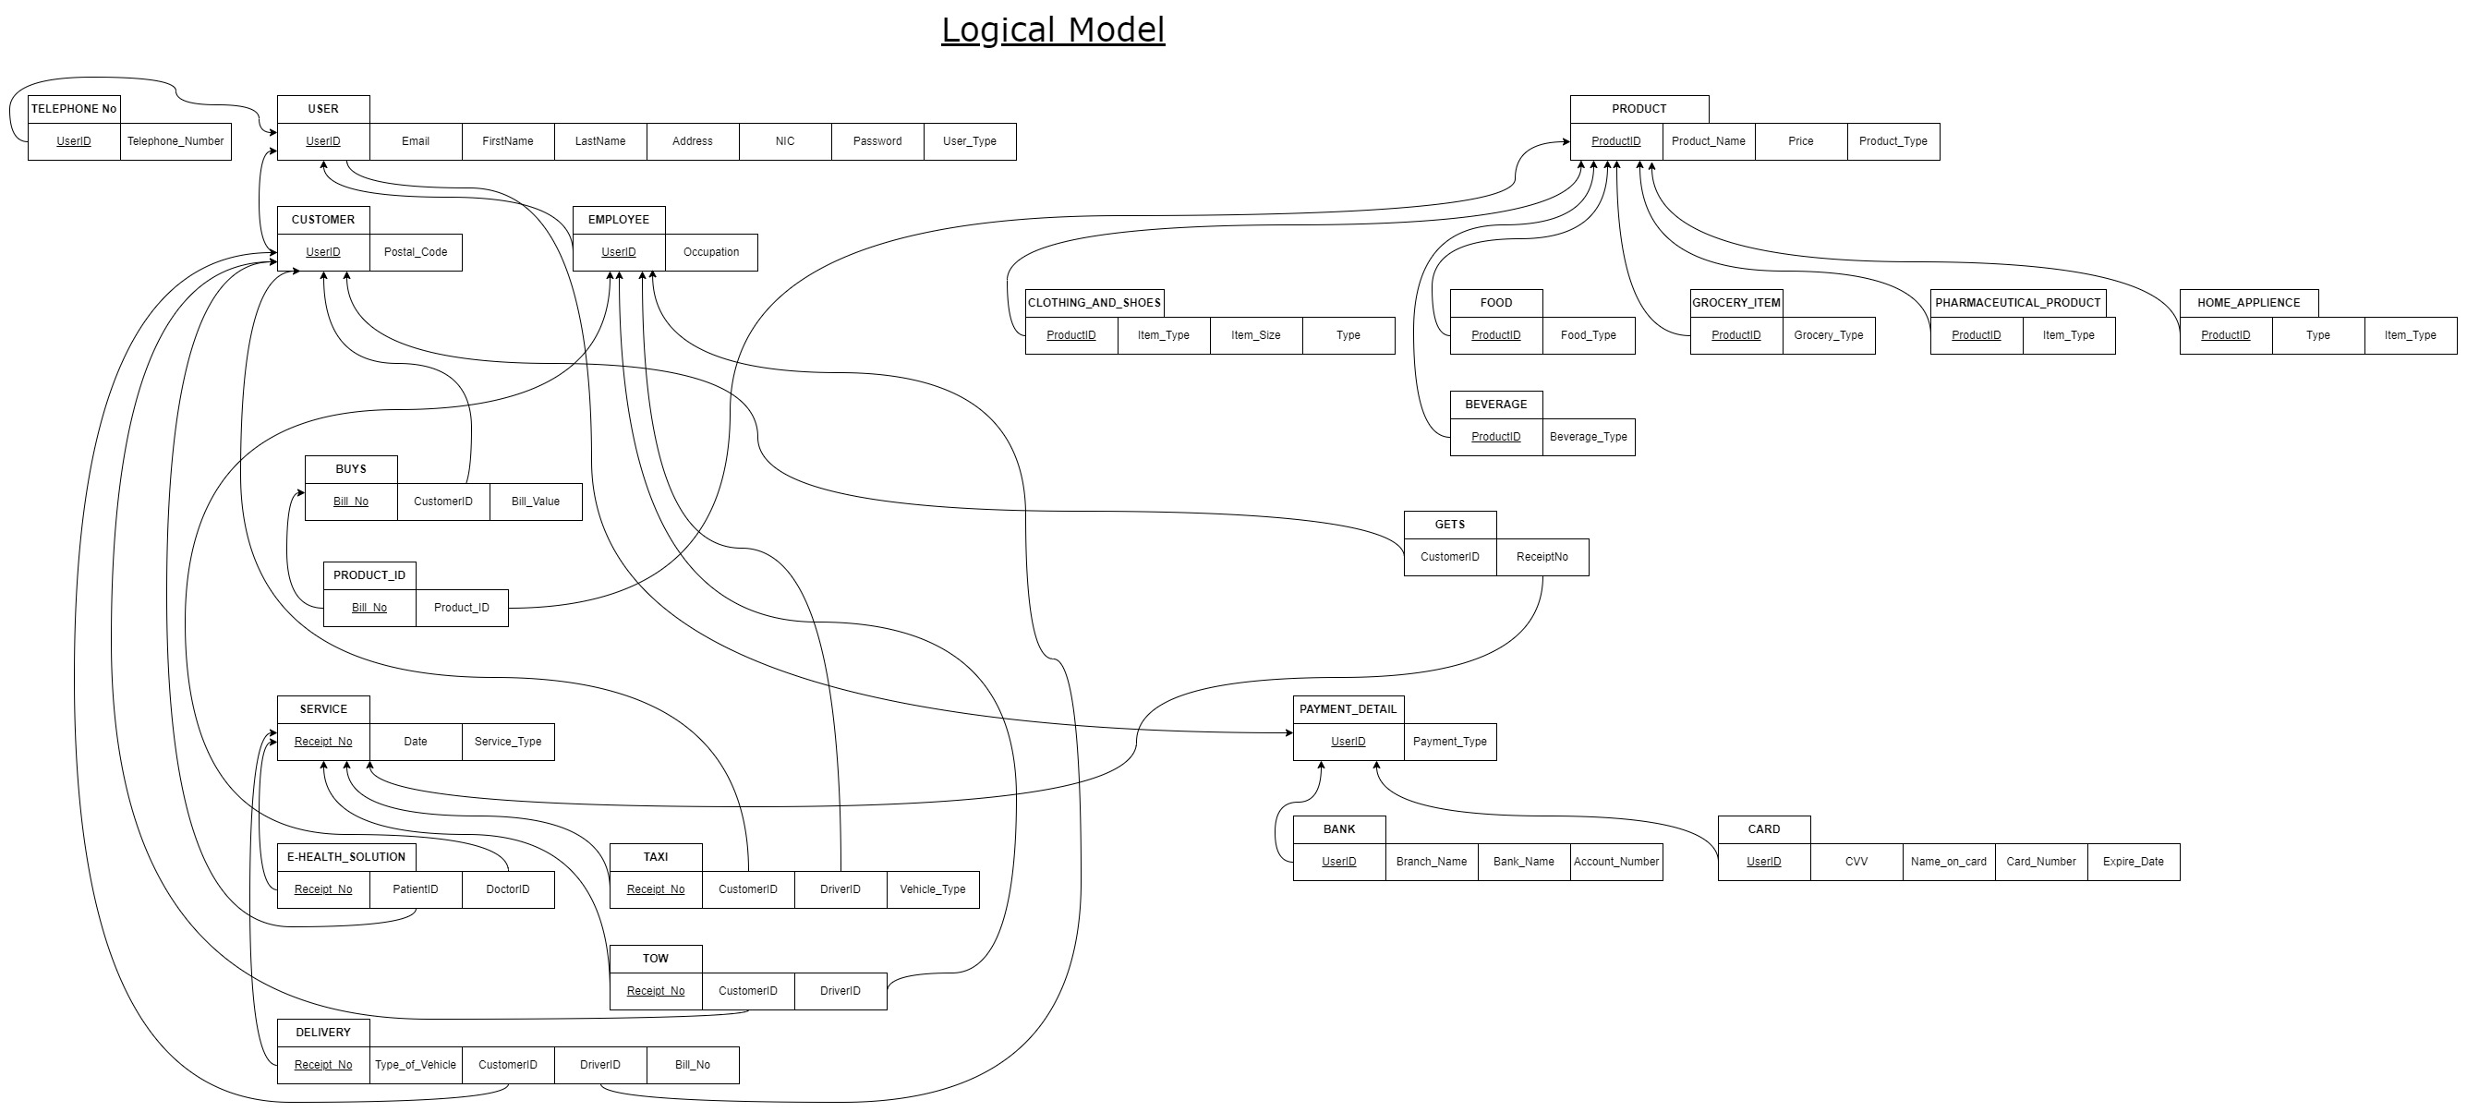
Logical Model

Slide 7
THANK YOU!
👍

